Slide 1
Entry M 4443.5 – Division in context of arrays
Part of Task Group M 4443 – Multiplication Arrays PowerPoint

Slide 2
I can…
… solve word problems about arrays and equal groups. I can write the matching multiplication and/or division sentence.
Click HERE to skip to first image.

Slide 3
Connections to CCSS
3.OA.2 Interpret whole-number quotients of whole numbers, e.g., interpret 56 ÷ 8 as the number of objects in each share when 56 objects are partitioned equally into 8 shares, or as a number of shares when 56 objects are partitioned into equal shares of 8 objects each.
3.OA.3 Use multiplication and division within 100 to solve word problems in situations involving equal groups, arrays and measurement quantities… (see Table 2 on next slide for types of word problems.)
3.OA.6 Understand division as an unknown-factor problem.
3.OA.7 Fluently multiply and divide within 100…
Click HERE for teacher directions

Slide 4
Click HERE to skip to first image.

Slide 5
Teacher Directions
Display the word problem. A supportive picture is hidden under the blue box which may be revealed during discussion.
Support students’ problem solving (while supporting picture is screened) with prompts such as
What do we know? What do we want to know?
If I want to draw a diagram, what information can help me do that?
If I want to draw an array, what do I know? What do I need to know? Try creating the array. (Students might use a 10x10 bead rack, dotted popsicle sticks, dotted strips or even counters.)
Color or mark the array on array paper. (Students could be given a 10 by 10 empty dot array and color or box in the corresponding array. Click here for pdf of the empty array. The array can be laminated or slipped into a page protector for repeated use. Alternatively, students could be given a large L shaped piece of cardstock to frame the matching array. See examples on the next two slides.)
Draw a picture or diagram that will help you figure this out. (A diagram is a simplified drawing of the picture that doesn’t involve drawing each individual item. Diagrams are more advanced and more easily extend to larger numbers. See examples on the next two slides.)
Click HERE to skip to first image.
Notes:
This slide is for teacher use and need not be shown to students. Highlight strategies that involve skip counting or stress counting (i.e. counting all items in one set before starting to count another). Less advanced students need experiences connecting skip counting to visible quantities.

Slide 6
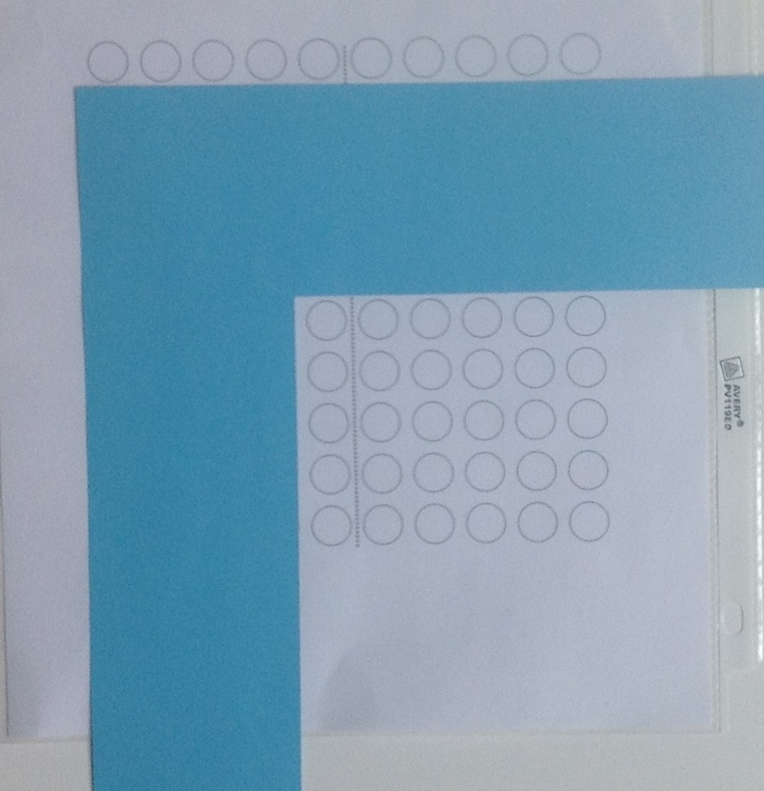
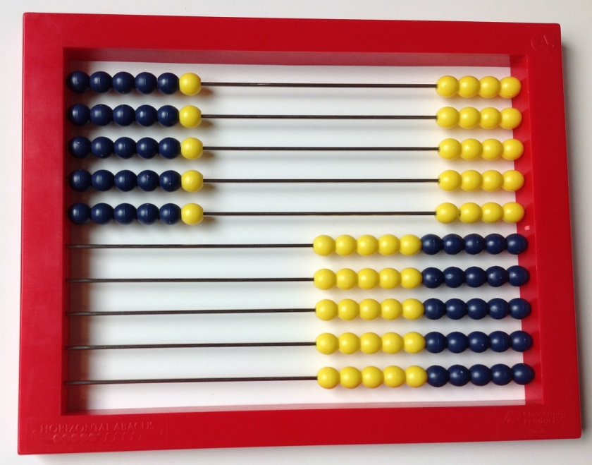
Examples for modeling a 5 x 6 array
Pictures
(top) 10 x 10 bead rack
(right) L shaped screen on a 10 x 10 array grid
Click HERE to skip to first image.
Notes:
This slide is for teacher use and need not be shown to students. Highlight strategies that involve skip counting or stress counting (i.e. counting all items in one set before starting to count another). Less advanced students need experiences connecting skip counting to visible quantities.

Slide 7
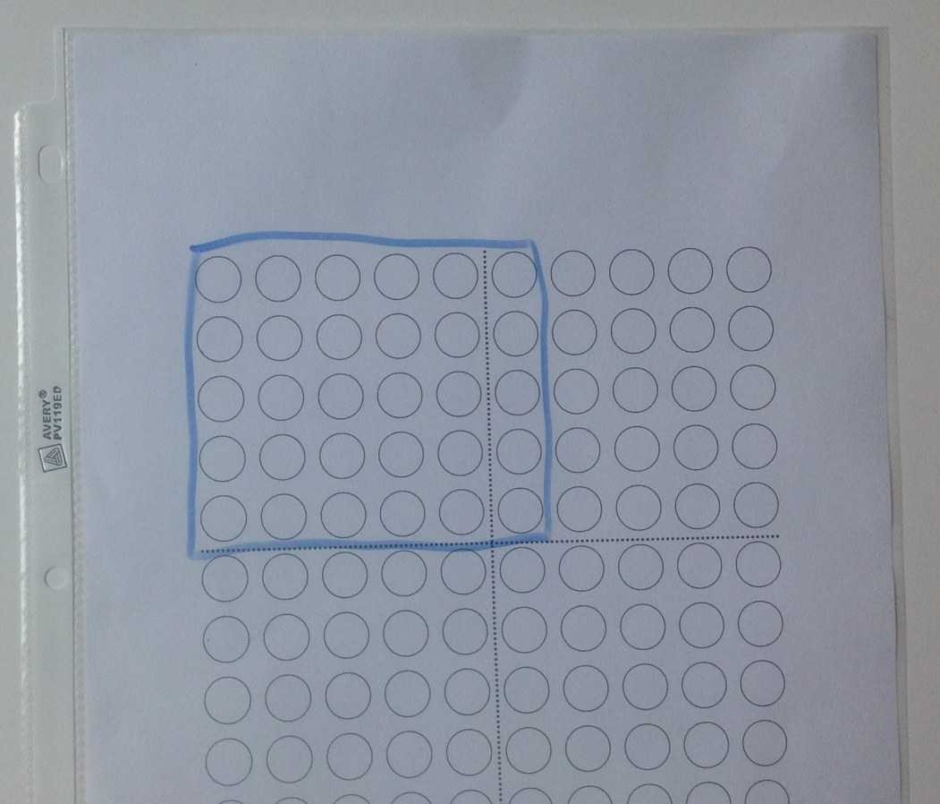
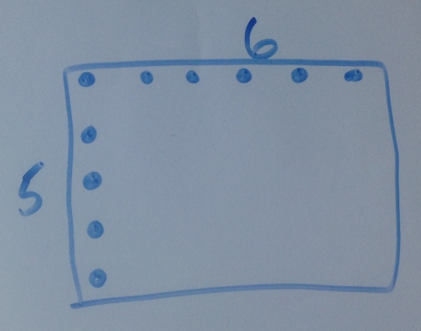
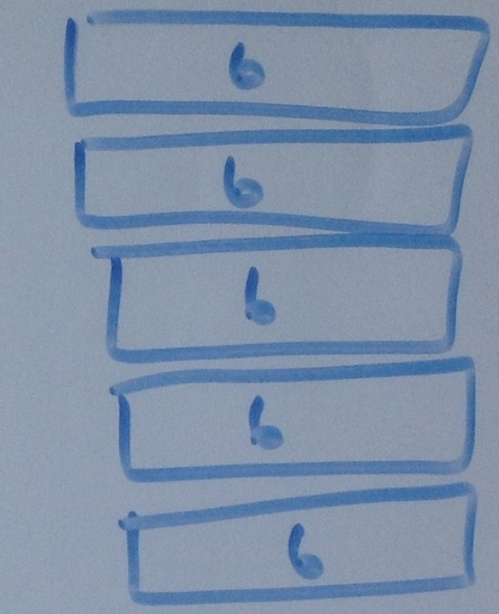
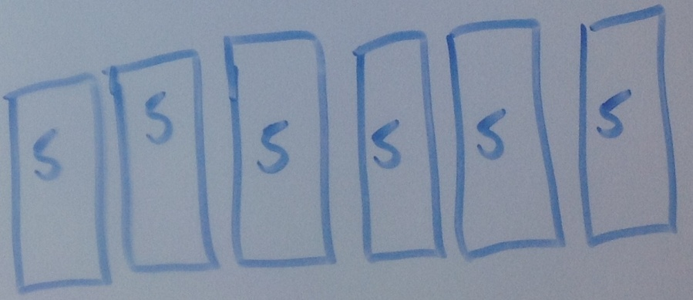
Examples for modeling a 5 x 6 array
Pictures clockwise starting top
Array marked on a 10 x 10 grid
Array with only top row and first column marked
Diagram showing rows
Diagram showing columns
Click HERE to skip to first image.
Notes:
This slide is for teacher use and need not be shown to students. Highlight strategies that involve skip counting or stress counting (i.e. counting all items in one set before starting to count another). Less advanced students need experiences connecting skip counting to visible quantities.

Slide 8
Task 1

Slide 9
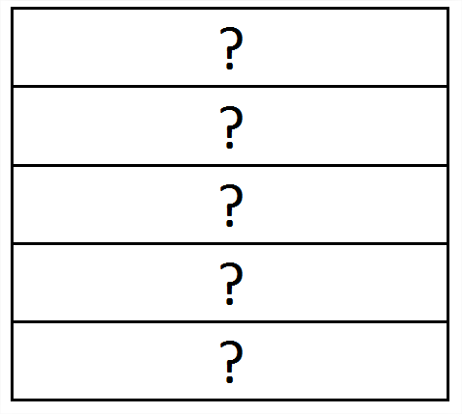
If 15 chairs are arranged into 5 rows, how many are in each row?
Click “ENTER” to uncover
Click “ENTER” to uncover
Notes:
And then reveal for discussion.

Slide 10
Task 2

Slide 11
Mrs. Richards gave 4 candies to each child. If she gave 20 candies, how many children received candies?
Click “ENTER” to uncover
Click ENTER to uncover
How many groups of 4?
Notes:
And then reveal for discussion.

Slide 12
Task 3

Slide 13
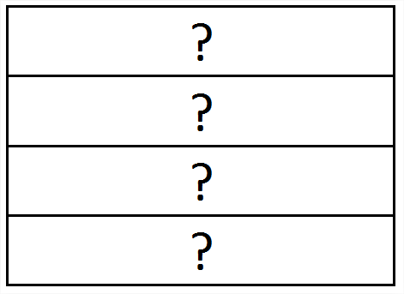
If 16 cupcakes are shared into 4 groups, how many are in each group?
Click “ENTER” to uncover
Click “ENTER” to uncover
Notes:
And then reveal for discussion.

Slide 14
Task 4

Slide 15
The grocer packs 18 plums into bags containing 6 plums each. How many bags did the grocer use?
Click ENTER to uncover
Click “ENTER” to uncover
How many rows of 6?
Notes:
And then reveal for discussion.

Slide 16
Task 5

Slide 17
If 24 marbles are arranged into 6 equal columns, how many are in each column?
Click “ENTER” to uncover
Click “ENTER” to uncover
Notes:
And then reveal for discussion.

Slide 18
Task 6

Slide 19
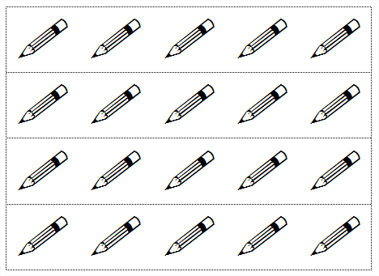
Kathy has 20 pencils. She splits them into groups of 5. How many groups can she make?
Click “ENTER” to uncover
Click ENTER to uncover
How many rows of 5?
Notes:
And then reveal for discussion.

Slide 20
Task 7

Slide 21
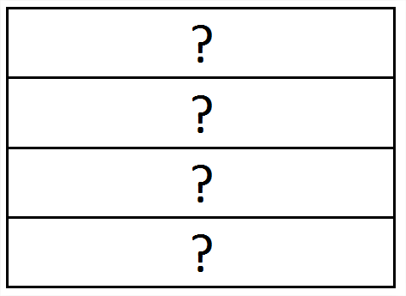
Sadie gives her 4 friends a total of 12 candies. If the friends share equally, how many candies does each child get?
Click “ENTER” to uncover
Click ENTER to uncover
Notes:
And then reveal for discussion.

Slide 22
Task 8

Slide 23
If 18 dots are arranged into 3 equal rows, how many are in each row?
Click “ENTER” to uncover
Click “ENTER” to uncover
Notes:
And then reveal for discussion.

Slide 24
Task 9

Slide 25
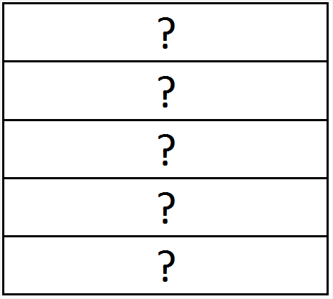
Will has 30 Pokémon cards. He organizes them into 5 equal rows. How many are in each row?
Click ENTER to uncover
Click “ENTER” to uncover
Notes:
And then reveal for discussion.

Slide 26
Extension tasks
Task 10

Slide 27
Caden has 16 cards. He wants to arrange them in an array. What is an array he can make so that no cards are leftover? What is another?
Click “ENTER” to see some examples…
Notes:
And then reveal for discussion.

Slide 28
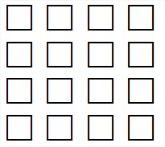
Arrays with 16 cards.
4 x 4
2 x 8
1 x 16
Notes:
And then reveal for discussion.

Slide 29
Arrays with 16 cards.
8 x 2
4 x 4
16 x 1
Also…
Notes:
And then reveal for discussion.

Slide 30
Extension tasks
Task 11

Slide 31
Mark has 24 cards. He wants to arrange them in an array. What is an array he can make so that no cards are leftover? What is another?
Click “ENTER” to see some examples…
Notes:
And then reveal for discussion.

Slide 32
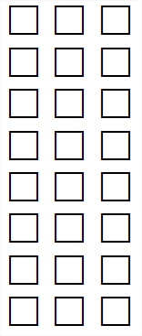
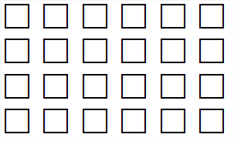
Arrays with 24 cards.
4 x 6
3 x 8
1 x 24
2 x 12
Notes:
And then reveal for discussion.

Slide 33
Arrays with 24 cards.
6 x 4
24 x 1
8 x 3
12 x 2
Also…
Notes:
And then reveal for discussion.

Slide 34
Extension tasks
Task 12

Slide 35
The baker is packaging cupcakes in packages of 12. How many packages can he fill with 60 cupcakes?
Task 12a:
Notes:
And then reveal for discussion.

Slide 36
The baker is packaging cupcakes in packages of 12. How many packages can he fill with 50 cupcakes?
Task 12b:
Notes:
And then reveal for discussion.

Slide 37
Extension tasks
Task 13

Slide 38
The grocer has 70 apples.
(a) If he displays his apples in rows of 10, how many rows will he have?
7 rows of 10
Click “ENTER” to uncover
Notes:
And then reveal for discussion.

Slide 39
The grocer has 70 apples.
(b) If he changes his display so that his apples are in rows of 5, how many rows will he have?
Click “ENTER” to uncover
Notes:
And then reveal for discussion.

Slide 40
The following excerpts come from:
Progressions for the Common Core
State Standards in Mathematics (draft)
The Common Core Standards Writing Team
29 May 2011
This document is available at:
http://commoncoretools.me/2011/05/29/complete-draft-progression-for-cc-and-oa/

Slide 41
Levels in problem representation and solution
Multiplication and division problem representations and solution methods can be considered as falling within three levels related to the levels for addition and subtraction (see Appendix). Level 1 is making and counting all of the quantities involved in a multiplication or division. As before, the quantities can be represented by objects or with a diagram, but a diagram affords reflection and sharing when it is drawn on the board and explained by a student. ... 2.OA.4 focuses
on using addition to find the total number of objects arranged
in rectangular arrays (up to 5 by 5).
Level 2 is repeated counting on by a given number, such as for 3:
3; 6; 9; 12; 15; 18; 21; 24; 27; 30. The count-bys give the running total. The number of 3s said is tracked with fingers or a visual or physical (e.g., head bobs) pattern. For 8 x 3, you know the number of 3s and count by 3 until you reach 8 of them.
Page 25 – main text

Slide 42
Supporting Level 2 methods with arrays
Small arrays (up to 5 x 5) support seeing and beginning to learn
the Level 2 count-bys for the first five equal groups of the small
numbers 2 through 5 if the running total is written to the right of
each row (e.g., 3, 6, 9, 12, 15). Students may write repeated
additions and then count by ones without the objects, often
emphasizing each last number said for each group. Grade 3
students can be encouraged to move as early as possible from
equal grouping or array models that show all of the quantities to
similar representations using diagrams that show relationships
of numbers because diagrams are faster and less error-prone
and support methods at Level 2 and Level 3. Some
demonstrations of methods or of properties may need to fall
back to initially showing all quantities along with a diagram.
(side box – page 25)

Slide 43
Pictures for use in ppt

