Slide 1

Entry M 4443.4 – Multiplication in context of arrays
Part of Task Group M 4443 – Multiplication Arrays PowerPoint

Slide 2

I can…
… solve word problems about arrays. I can write the matching multiplication sentence.
Click HERE to skip to first image.

Slide 3
Connections to CCSS
3.OA.1 Interpret products of whole numbers, e.g., interpret 5 x 7 as the total number of objects in 5 groups of 7 objects each.
3.OA.3 Use multiplication and division within 100 to solve word problems in situations involving equal groups, arrays and measurement quantities… (see Table 2 on next slide for types of word problems.)
3.OA.7 Fluently multiply and divide within 100…
Click HERE for teacher directions

Slide 4
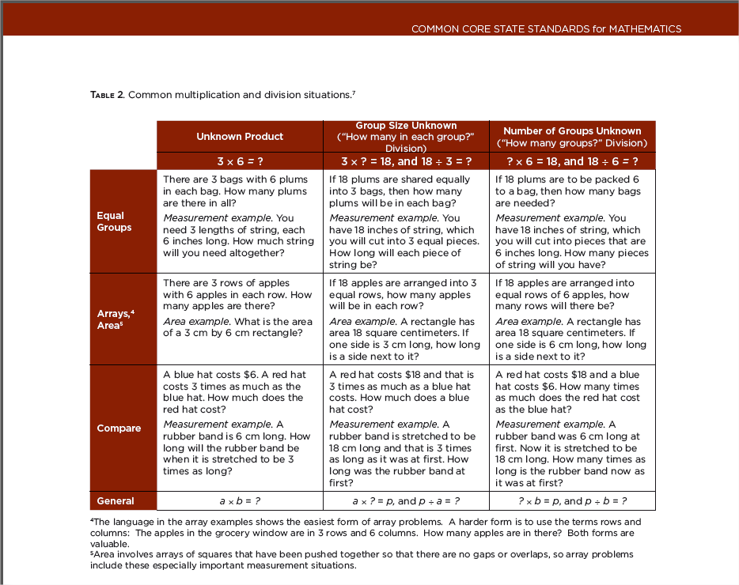

Click HERE to skip to first image.

Slide 5
Teacher Directions
Display the word problem. A supportive picture is hidden under the blue box. This picture may be revealed and used to support conversation about the task.
To support students’ problem solving, use prompts such as
  What do we know?
  What do we want to know?
  How can we figure that out? (Some students may continue to use skip counting to solve. Others may “just know” some facts and may be able to anchor to know facts to work out others. For example, a student may use the known fact that 3x4 = 12 to work out 4x4 =16.)
  Is there another way to solve this problem?
  What is a multiplication sentence that matches this situation? (More than one multiplication sentence might apply. You may also wish to model writing the equation with a variable or “?” in the unknown position of the equation.)
Click HERE to skip to first image.
Notes:
This slide is for teacher use and need not be shown to students. Highlight strategies that involve skip counting or stress counting (i.e. counting all items in one set before starting to count another). Less advanced students need experiences connecting skip counting to visible quantities.

Slide 6
Teacher Directions
Some students may need support “seeing” the problem. These students may benefit from making drawing or diagrams or acting the story problem out with materials. Some prompts may include:
  What picture might go with this problem? (Look for multiplicative language i.e. “__ groups of __”, or “__ rows of ___”.)
  Build an array that would help us solve this. (Students might use a 10x10 bead rack, dotted popsicle sticks, dotted strips or even counters.
  Color or mark the array on array paper. (Students could be given a 10 by 10 empty dot array and color or box in the corresponding array. Click here for pdf of the empty array. The array can be laminated or slipped into a page protector for repeated use. Alternatively, students could be given a large L shaped piece of cardstock to frame the matching array. See examples on the next two slide.)
  Draw a picture or diagram that will help you figure this out. (A diagram is a simplified drawing of the picture that doesn’t involve drawing each individual item. Diagrams are more advanced and more easily extend to larger numbers. See examples on the next two slides.)
Click HERE to skip to first image.
Notes:
This slide is for teacher use and need not be shown to students. Highlight strategies that involve skip counting or stress counting (i.e. counting all items in one set before starting to count another). Less advanced students need experiences connecting skip counting to visible quantities.

Slide 7
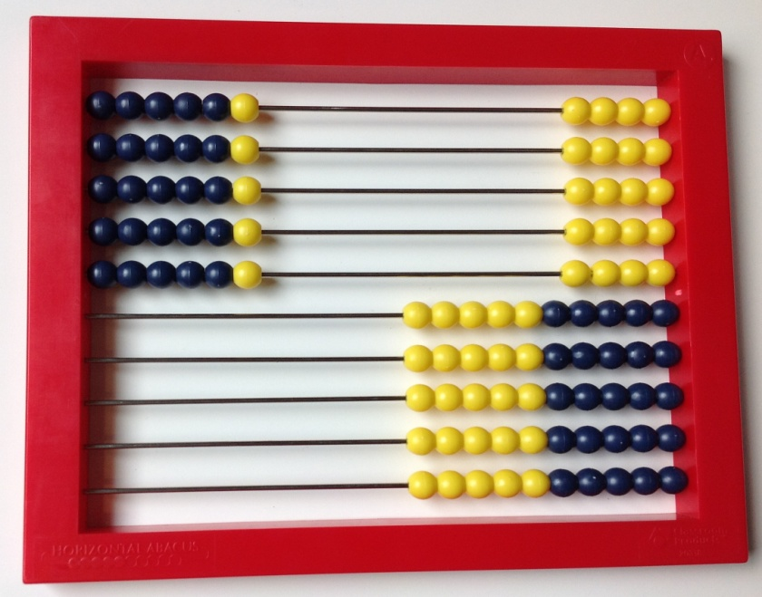
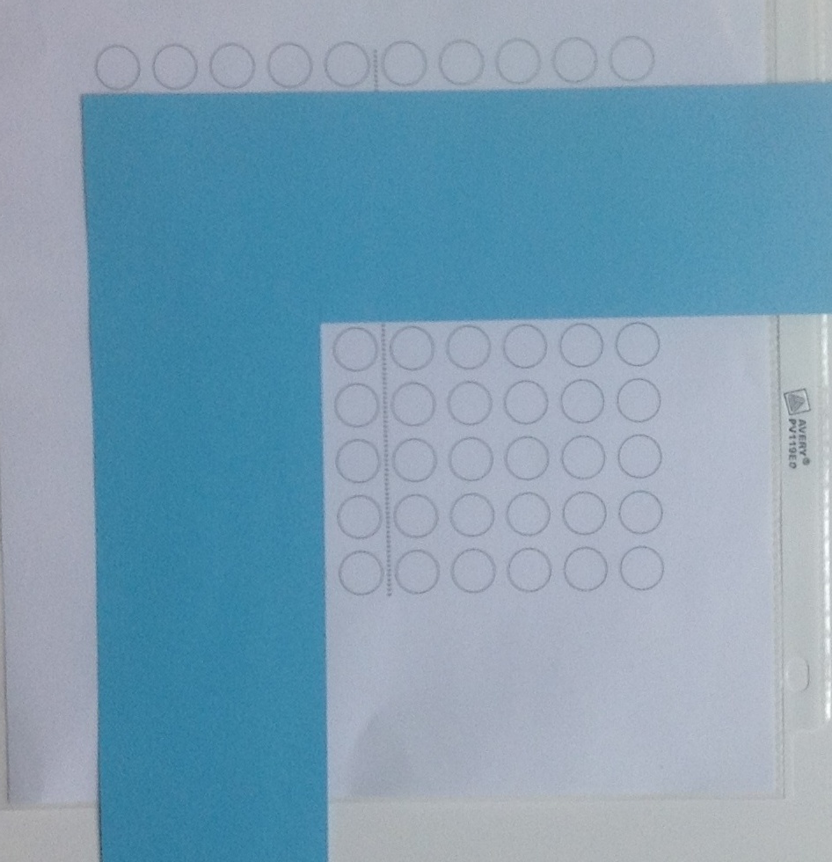
Examples for modeling a 5 x 6 array
Pictures
(top) 10 x 10 bead rack
(right) L shaped screen on a 10 x 10 array grid
Click HERE to skip to first image.
Notes:
This slide is for teacher use and need not be shown to students. Highlight strategies that involve skip counting or stress counting (i.e. counting all items in one set before starting to count another). Less advanced students need experiences connecting skip counting to visible quantities.

Slide 8
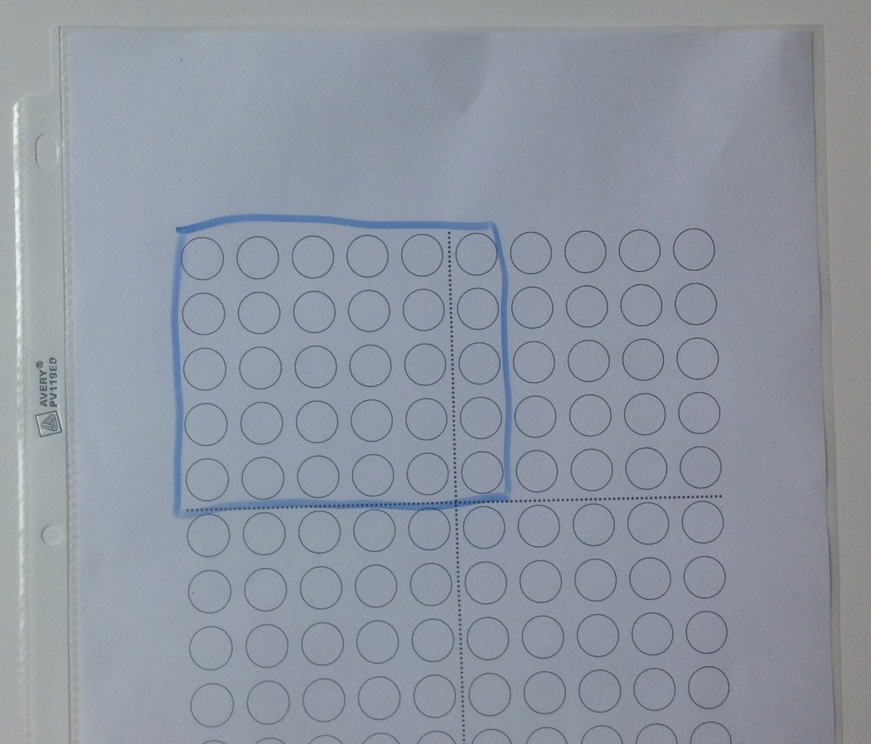
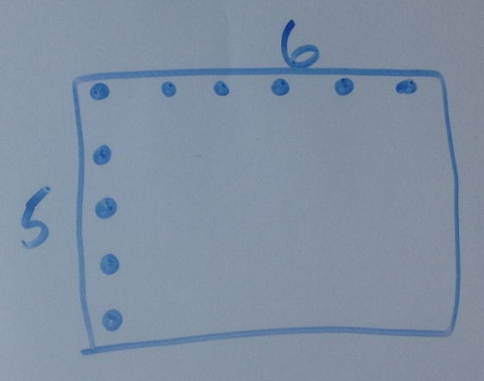
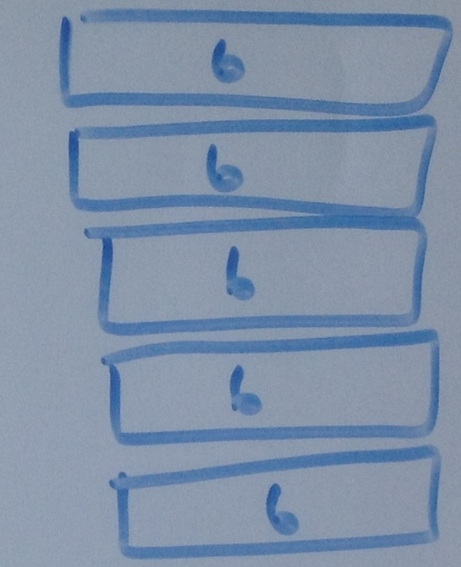
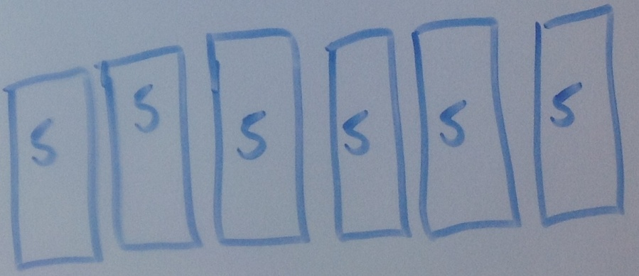
Examples for modeling a 5 x 6 array
Pictures clockwise starting top
Array marked on a 10 x 10 grid
Array with only top row and first column marked
Diagram showing rows
Diagram showing columns
Notes:
This slide is for teacher use and need not be shown to students. Highlight strategies that involve skip counting or stress counting (i.e. counting all items in one set before starting to count another). Less advanced students need experiences connecting skip counting to visible quantities.

Slide 9
Task 1

Slide 10

The bakery displays cupcakes in 2 rows of 3. How many cupcakes are displayed?
Click ENTER to uncover
Notes:
And then reveal for discussion.

Slide 11
Task 2

Slide 12
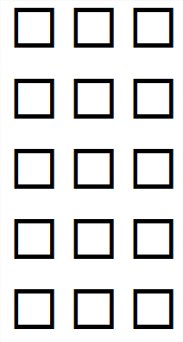
The tables are arranged in 3 rows. Each row has 5 tables. How many tables are there in all?
Click ENTER to uncover
Notes:
And then reveal for discussion.

Slide 13
Task 3

Slide 14

The cookies are arranged in 2 rows. Each row has 4 cookies. How many cookies are there in all?
Click ENTER to uncover
Notes:
And then reveal for discussion.

Slide 15
Task 4

Slide 16
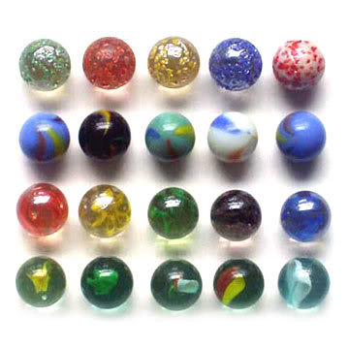
Kathy has placed her marbles in 5 rows of 4. How many marbles does Kathy have?
Click ENTER to uncover
Notes:
And then reveal for discussion.

Slide 17
Task 5

Slide 18
The fisherman ties his caught fish in groups of 5. He has 4 groups. How many fish has he caught?
Click ENTER to uncover
Notes:
And then reveal for discussion.

Slide 19
Task 6

Slide 20

The dots are arranged in 5 rows and 4 columns. How many dots are there in all?
Click ENTER to uncover
Notes:
And then reveal for discussion.

Slide 21
Task 7

Slide 22

The Pokemon cards are placed in groups of 4. There are 6 groups. How many cards are there?
Click ENTER to uncover
Notes:
And then reveal for discussion.

Slide 23
Task 8

Slide 24

The dots are arranged in 4 rows of 4 dots each. How many dots are there in all?
Click ENTER to uncover
Notes:
And then reveal for discussion.

Slide 25
Task 9

Slide 26
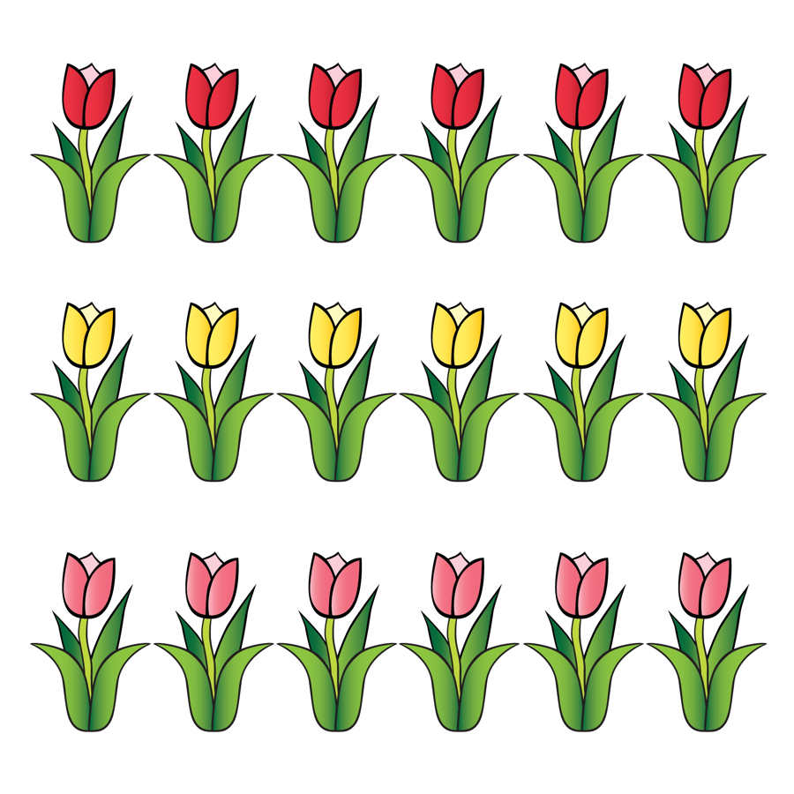
The flowers are arranged in 3 rows. There are 6 flowers in each row. How many flowers are there in all?
Click ENTER to uncover
Notes:
And then reveal for discussion.

Slide 27
Task 10

Slide 28

The grocer displays his apples in 3 rows and 4 columns. How many apples are in his display?
Click ENTER to uncover
Notes:
And then reveal for discussion.

Slide 29
Task 11

Slide 30

The baker packages his cupcakes in 4 rows and 6 columns. How many cupcakes are in a package?
Click ENTER to uncover
Notes:
And then reveal for discussion.

Slide 31
Task 12

Slide 32
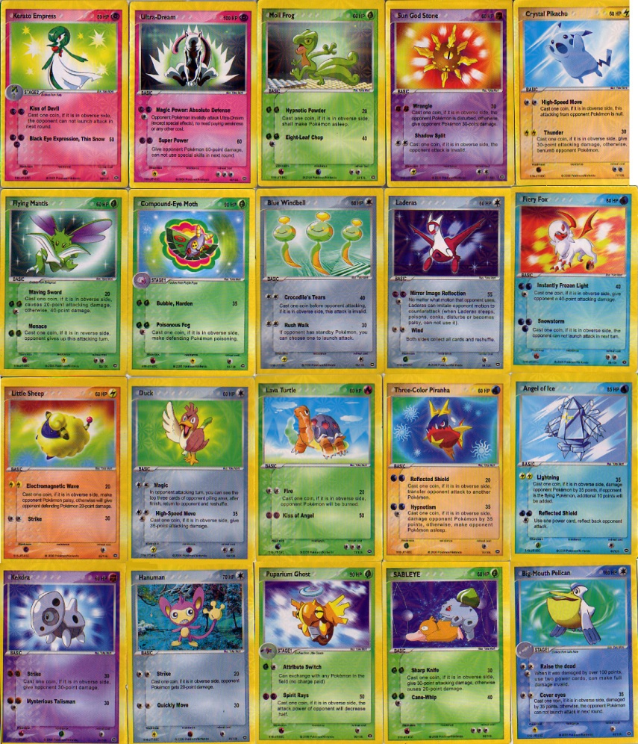
The pokemon cards are arranged in a 4 by 5 array. How many cards are there in all?
Click ENTER to uncover
Notes:
And then reveal for discussion.

Slide 33
The following excerpt come from:
Progressions for the Common Core
State Standards in Mathematics (draft)
The Common Core Standards Writing Team
29 May 2011
This document is available at:
http://commoncoretools.me/2011/05/29/complete-draft-progression-for-cc-and-oa/

Slide 34
Supporting Level 2 methods with arrays
Small arrays (up to 5 x 5) support seeing and beginning to learn
the Level 2 count-bys for the first five equal groups of the small
numbers 2 through 5 if the running total is written to the right of
each row (e.g., 3, 6, 9, 12, 15). Students may write repeated
additions and then count by ones without the objects, often
emphasizing each last number said for each group. Grade 3
students can be encouraged to move as early as possible from
equal grouping or array models that show all of the quantities to
similar representations using diagrams that show relationships
of numbers because diagrams are faster and less error-prone
and support methods at Level 2 and Level 3. Some
demonstrations of methods or of properties may need to fall
back to initially showing all quantities along with a diagram.
(side box – page 25)

Slide 35
Thank You!
Please visit www.kymath.org for more information.

