Slide 1
Entry M 4443.2 – Counting items arranged in groups and arrays
Part of Task Group M 4443 – Multiplication Arrays PowerPoint

Slide 2
I can…
… determine how many items in all when items are arranged in an array or in equal groups. I can write an addition sentence to match the picture.
Click HERE to skip to first image.
Notes:
For example “5 groups of 3” or “There are 5 groups and each group has 3 dots” or “There are 5 sets of 3 dots each”. Arrays might be described as “5 rows of 3 dots each” or “there are 5 rows and 3 columns” or “there are 5 rows and each row has 3 dots” or “there are 3 columns and each column has 5 dots”.

Slide 3
Connections to CCSS
2.OA.4 Use addition to find the total number of objects arranged in rectangular arrays with up to 5 rows and 5 columns; write an equation to express the total as a sum of equal addends.
This activity also supports:
3.OA.1 Interpret products of whole numbers, e.g., interpret 5 x 7 as the total number of objects in 5 groups of 7 objects each.
Click HERE to skip to first image.

Slide 4
Teacher Directions
Display an image, leaving the image available for students to see and discuss.
Give discussion prompts such as
What do you see? (Look for language that shows students are seeing the organization of the dots, i.e. groups, rows, columns, array, etc.)
How are the dots organized?
How can we count the dots? Show me! What’s another way to count the dots? (For many of the images in the powerpoint, at least one skip counting sequence can be shown by repeatedly selecting ENTER. To omit the skip counting sequence, click on the link in the lower right corner. You may prefer to do your own recording for counting strategies using smart board tools or by writing directly on a white board. As an extension, you might ask students to consider if it’s easier to count by columns or rows.)
What is an addition sentence that matches this picture? (Eventually extend to asking for two addition sentences. For example, a 3 by 4 array matches 3+3+3+3=12 and 4+4+4=12.) It may be helpful to do this after the skip counting and while only the total number of dots is being displayed.
Click HERE to skip to first image.
Notes:
This slide is for teacher use and need not be shown to students. Highlight strategies that involve skip counting or stress counting (i.e. counting all items in one set before starting to count another). Less advanced students need experiences connecting skip counting to visible quantities.

Slide 5
Teacher Directions
Technical note:
The skip counts are added to the slide using “animations” in PowerPoint. If you want to “reset” an image so that the skips counts are no longer showing, or you want to show the skip counts a second time, click on the back arrow until the slide is reset.
Click HERE to skip to first image.
Notes:
This slide is for teacher use and need not be shown to students. Highlight strategies that involve skip counting or stress counting (i.e. counting all items in one set before starting to count another). Less advanced students need experiences connecting skip counting to visible quantities.

Slide 6
Click or push ENTER for next image

Slide 7
M 4443.2
5
10
15
Click here for new image
Or choose ENTER to show skip counts.

Slide 8
Click or push ENTER for next image

Slide 9
3
6
9
12
15
Click here for new image
Or choose ENTER to show skip counts.

Slide 10
Click or push ENTER for the first image

Slide 11
We can also skip count by 6s
6
12
2
4
6
8
10
12
Click here for new image
Or choose ENTER to show skip counts.
Notes:
4 rows of 3, 4 groups of 3

Slide 12
Click or push ENTER for next image

Slide 13
We can skip count by 2s
5
10
We can also skip count by 5s
2
4
6
8
10
Click here for new image
Or choose ENTER to show skip counts.

Slide 14
Click or push ENTER for the first image

Slide 15
We can skip count by 3s
6
12
3
9
4
8
12
We can also skip count by 4s
Click here for new image
Or choose ENTER to show skip counts.

Slide 16
Click or push ENTER for next image

Slide 17
We can also skip count by 3s
15
3
6
9
12
5
We can skip count by 5s
10
15
Click here for new image
Or choose ENTER to show skip counts.
Notes:
3 rows of 5,
3 sets of 5
3 rows, each with 5 dots.

Slide 18
Click or push ENTER for next image

Slide 19
We can skip count by 4s
5
10
15
20
20
4
8
12
16
We can also skip count by 5s
Click here for new image
Or choose ENTER to show skip counts.
Notes:
4 rows of 3, 4 groups of 3

Slide 20
Click or push ENTER for next image

Slide 21
3
What is a different way to count the cats?
6
9
12
Click here for new image
Or choose ENTER to show skip counts.

Slide 22
Click or push ENTER for next image

Slide 23
5
10
Click here for new image
Or choose ENTER to show skip counts.

Slide 24
Click or push ENTER for next image

Slide 25
5
10
What happens if we count the columns?
15
20
25
Click here for new image
Or choose ENTER to show skip counts.

Slide 26
Click or push ENTER for next image

Slide 27
We can skip count by 2s
2
4
6
We can also skip count by 4s
8
4
8
Click here for new image
Or choose ENTER to show skip counts.

Slide 28
Click or push ENTER for next image

Slide 29
3
6
9
Click here for new image
Or choose ENTER to show skip counts.

Slide 30
Click or push ENTER for next image

Slide 31
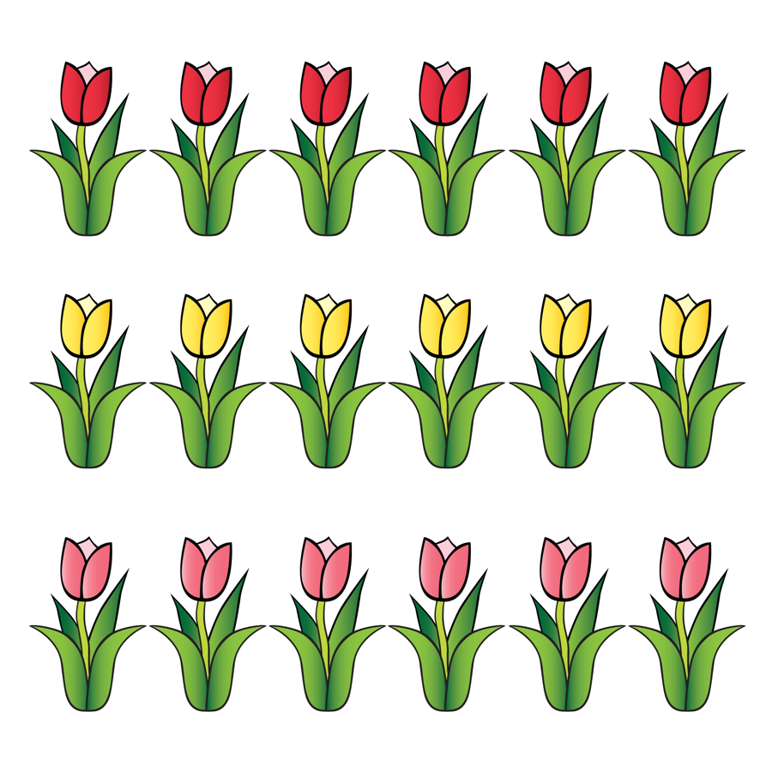
6
We can skip count by 6s
We can also skip count by 3s
12
18
3
6
9
12
15
18
Click here for new image
Or choose ENTER to show skip counts.
Notes:
3 rows of 5

Slide 32
Click or push ENTER for next image

Slide 33
3
We can skip count by 3s
6
We can also skip count by 5s
9
12
15
5
10
15
Click here for new image
Or choose ENTER to show skip counts.
Notes:
5 groups of 5

Slide 34
Click or push ENTER for next image

Slide 35
How many dots?
Notes:
5 groups of 5

Slide 36
Click or push ENTER for next image

Slide 37
How many dots?
Notes:
5 groups of 5

Slide 38
Click or push ENTER for next image

Slide 39
How many dots?
Notes:
5 groups of 5

Slide 40
Click or push ENTER for next image

Slide 41
How many dots?
Notes:
5 groups of 5

Slide 42
The following excerpts come from:
Progressions for the Common Core
State Standards in Mathematics (draft)
The Common Core Standards Writing Team
29 May 2011
This document is available at:
http://commoncoretools.me/2011/05/29/complete-draft-progression-for-cc-and-oa/

Slide 43
Levels in problem representation and solution
Multiplication and division problem representations and solution methods can be considered as falling within three levels related to the levels for addition and subtraction (see Appendix). Level 1 is making and counting all of the quantities involved in a multiplication or division. As before, the quantities can be represented by objects or with a diagram, but a diagram affords reflection and sharing when it is drawn on the board and explained by a student. ... 2.OA.4 focuses
on using addition to find the total number of objects arranged
in rectangular arrays (up to 5 by 5).
Level 2 is repeated counting on by a given number, such as for 3:
3; 6; 9; 12; 15; 18; 21; 24; 27; 30. The count-bys give the running total. The number of 3s said is tracked with fingers or a visual or physical (e.g., head bobs) pattern. For 8 x 3, you know the number of 3s and count by 3 until you reach 8 of them.
Page 25 – main text

Slide 44
Supporting Level 2 methods with arrays
Small arrays (up to 5 x 5) support seeing and beginning to learn
the Level 2 count-bys for the first five equal groups of the small
numbers 2 through 5 if the running total is written to the right of
each row (e.g., 3, 6, 9, 12, 15). Students may write repeated
additions and then count by ones without the objects, often
emphasizing each last number said for each group. Grade 3
students can be encouraged to move as early as possible from
equal grouping or array models that show all of the quantities to
similar representations using diagrams that show relationships
of numbers because diagrams are faster and less error-prone
and support methods at Level 2 and Level 3. Some
demonstrations of methods or of properties may need to fall
back to initially showing all quantities along with a diagram.
(side box – page 25)

Slide 45
Thank You!
Please visit www.kymath.org for more information.

