Slide 1

Entry M 4443.1 – Describing Groups and Arrays
Part of Task Group M 4443 – Multiplication Arrays PowerPoint

Slide 2

I can…
… describe quantities arranged in equal groups or arrays.
Click HERE to skip to first image.
Notes:
Help students use mathematical language. Examples: “5 groups of 3” or “There are 5 groups and each group has 3 dots” or “There are 5 sets of 3 dots each”. Arrays might be described as “5 rows of 3 dots” or “there are 5 rows and 3 columns” or “there are 5 rows and each row has 3 dots” or “there are 3 columns and each column has 5 dots”.

Slide 3
Connections to CCSS
This activity is foundational for the following standards:
2.OA.4 Use addition to find the total number of objects arranged in rectangular arrays with up to 5 rows and 5 columns; write an equation to express the total as a sum of equal addends.
3.OA.1 Interpret products of whole numbers, e.g., interpret 5 x 7 as the total number of objects in 5 groups of 7 objects each.
Click HERE to skip to first image.

Slide 4
Teacher Directions
Display an image, leaving the image available for students to see and discuss
Give discussion prompts such as
  Tell me something about this picture?
  How many groups are there?
  How many dots (items) are in each group? (Bring out words such as group, set, row, column and array and support students in using words correctly.)
  Initially, do not ask students about the total number of dots. The purpose of this activity is to help students attend to and be able to communicate about the group structure of the image. If students are asked too soon about the total number of dots, students will likely resort to counting dots by ones with little or no attention to the structure.
Click HERE to skip to first image.

Slide 5
Teacher Directions
Additional activity prompts may include
  Use counters to create what you see. (In place of counters, students could use dotted popsicle sticks or (for arrays) or dot strips.)
  Draw what you see. (For the arrays, students could be given the option of recording images on a 10 by 10 empty dot array. Click here for pdf of the empty array. The array can be laminated or slipped into a page protector for repeated use. As an alternative to coloring in the array, students can “frame” the array using an L shaped paper. See next slide.)
  Use a 10x10 bead rack to create what you see. (See next slide.)
These additional activities may help struggling students attend to the group structure and will give the teacher insight into what the student is attending to in the image.
Click HERE to skip to first image.

Slide 6
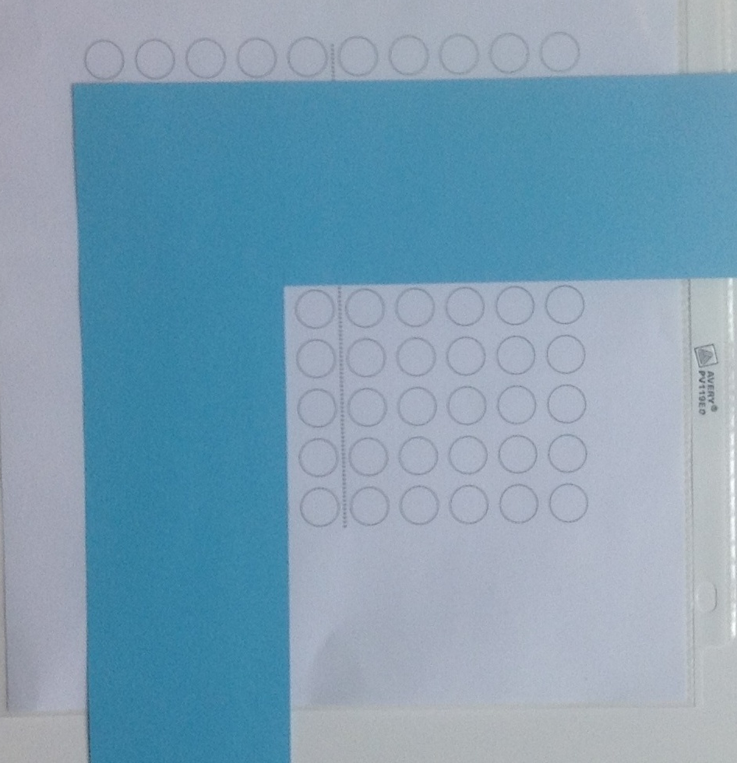
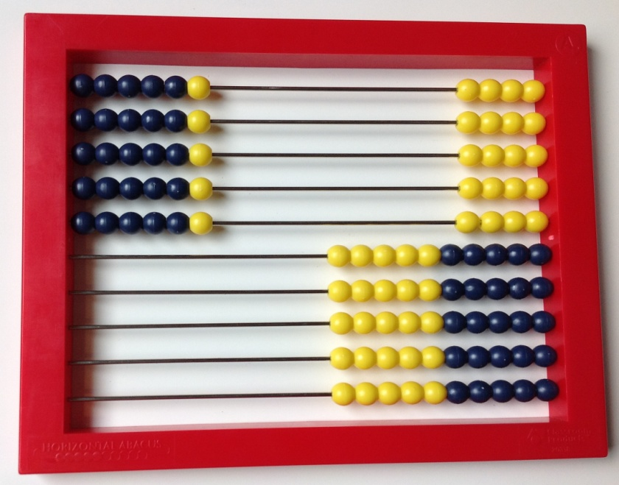
Examples for modeling a 5 x 6 array
Pictures
(top) 10 x 10 bead rack
(right) L shaped screen on a 10 x 10 array grid
Click HERE to skip to first image.
Notes:
This slide is for teacher use and need not be shown to students. Highlight strategies that involve skip counting or stress counting (i.e. counting all items in one set before starting to count another). Less advanced students need experiences connecting skip counting to visible quantities.

Slide 7
Teacher Directions
Technical note:
  The movement of the group images are added to the slide using “animations” in PowerPoint. If you want to reset a slide, click on the up arrow.
Click HERE to skip to first image.
Notes:
This slide is for teacher use and need not be shown to students. Highlight strategies that involve skip counting or stress counting (i.e. counting all items in one set before starting to count another). Less advanced students need experiences connecting skip counting to visible quantities.

Slide 8
Click or push ENTER for next image

Slide 9

Click ENTER to make an array

Slide 10
Click or push ENTER for next image

Slide 11

Click ENTER to make an array

Slide 12
Click or push ENTER for next image

Slide 13

Click ENTER to make an array

Slide 14
Click or push ENTER for next image

Slide 15

Click ENTER to make an array

Slide 16
Click or push ENTER for next image

Slide 17

Click ENTER to make an array

Slide 18
Click or push ENTER for next image

Slide 19
Click ENTER to make an array

Slide 20
Click or push ENTER for next image

Slide 21

Click ENTER to make an array

Slide 22
Click or push ENTER for next image

Slide 23

Click ENTER to make an array
Notes:
4 rows of 3, 4 groups of 3

Slide 24

Click or push ENTER for next image

Slide 25
Click ENTER to make an array
Notes:
4 rows of 3, 4 groups of 3

Slide 26
Click or push ENTER for next image

Slide 27

Click ENTER to make an array
Notes:
4 rows of 3, 4 groups of 3

Slide 28
Click or push ENTER for next image

Slide 29

Click ENTER to make an array
Notes:
4 rows of 3, 4 groups of 3

Slide 30
Click or push ENTER for next image

Slide 31
Click ENTER to make an array
Notes:
4 rows of 3, 4 groups of 3

Slide 32
Click or push ENTER for next image

Slide 33

Notes:
3 rows of 5,
3 sets of 5
3 rows, each with 5 dots.

Slide 34
Click or push ENTER for next image

Slide 35


Slide 36
Click or push ENTER for the first image

Slide 37
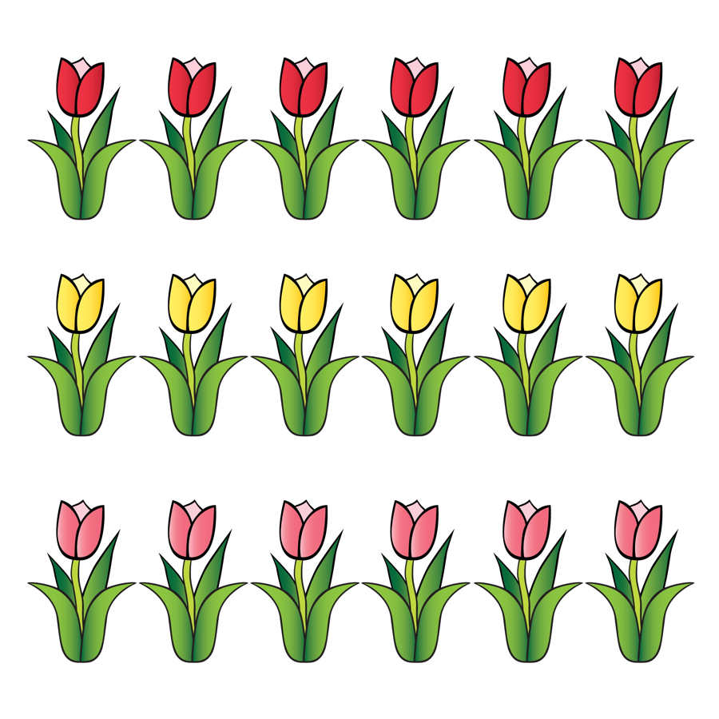
Notes:
3 rows of 5

Slide 38
Click or push ENTER for next image

Slide 39

Notes:
5 groups of 5

Slide 40
Click or push ENTER for next image

Slide 41
Notes:
5 groups of 5

Slide 42
Click or push ENTER for next image

Slide 43
Notes:
5 groups of 5

Slide 44
Click or push ENTER for next image

Slide 45

Notes:
5 groups of 5

Slide 46
Click or push ENTER for next image

Slide 47

Notes:
5 groups of 5

Slide 48
Click or push ENTER for next image

Slide 49

Notes:
5 groups of 5

Slide 50
Click or push ENTER for next image

Slide 51
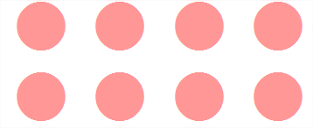
Notes:
5 groups of 5

Slide 52
Click or push ENTER for next image

Slide 53

Notes:
5 groups of 5

Slide 54
Click or push ENTER for next image

Slide 55
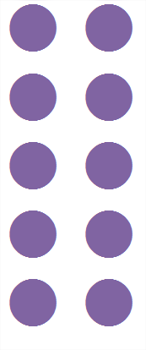
Notes:
5 groups of 5

Slide 56
Thank You!
Please visit www.kymath.org for more information.

