Slide 1
Multiplication Quick Images For use with KNP # M 435.3

Slide 10
Notes:
What do you see?
How many flower pots.
How many flowers in each pot?
How many flowers?
How many pink flowers?
How many red flowers?
What is an equation that matches this picture? Another?
Notes – Student may begin with either multiplicative or additive equations. Students might see this as 6 groups of 2, but they could also see it as 2 groups of 6 (i.e. 6 blue flowers and 6 red flowers). If so bring in this idea, it can be an opportunity to bring in the commutative property of multiplication.

Slide 13
Notes:
Some questions to ask:
What did you see?
How many stacks?
How many books in each stack?
How many book in all?
How many green books?
How many red books?
How many blue books?
What equation can you write?
Some examples of equations you might explore: 3+3+3+3+3 = 15, 5x3 = 15, 5+5+5 = 15 (i.e. 5 red + 5 blue + 5 green), 3 x 5 = 15. This slide might give a chance to discuss the commutative property of multiplication. (i.e. 5 stacks of 3 books OR 3 colored sets of 5 books (1 set ret, 1 set blue, 1 set green))

Slide 16
Notes:
Prompting questions:
What do you see?
How many cookies on each plate?
How many plates?
How many cookies?
How many chocolate cookies? How many vanilla cookies? How many peanut butter cookies?
What is an equation that matches this picture?

Slide 20
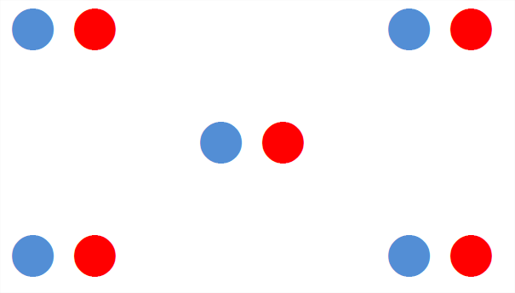

Slide 25
Notes:
What do you see?
How many flower pots.
How many flowers in each pot?
How many flowers?
How many pink flowers?
How many red flowers?
What is an equation that matches this picture? Another?
Notes – Student may begin with either multiplicative or additive equations. Students might see this as 9 groups of 2, but they could also see it as 2 groups of 9 (i.e. 9 blue flowers and 9 red flowers). If so bring in this idea, it can be an opportunity to bring in the commutative property of multiplication.
Students may also see the groups of groups. For example, a student might say that there are 6 flowers (3 groups of 2) in each row (column) and there are 3 rows (columns). The equation for that is 3 ( 3*2). So this brings in the idea of associative property: 3 * 3 * 2 = (3*3)*2= 3* (3*2)

Slide 35
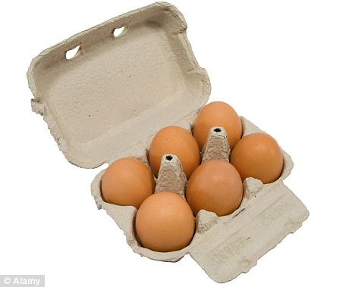

Slide 65
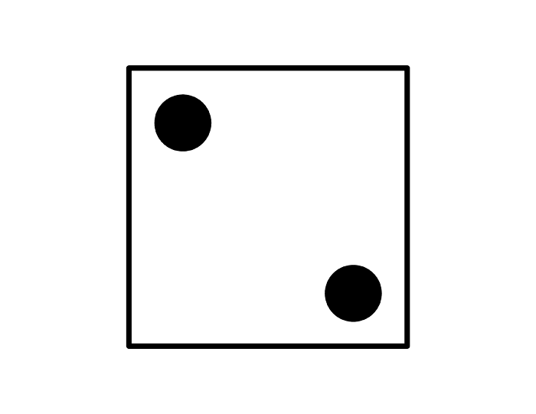

Slide 71
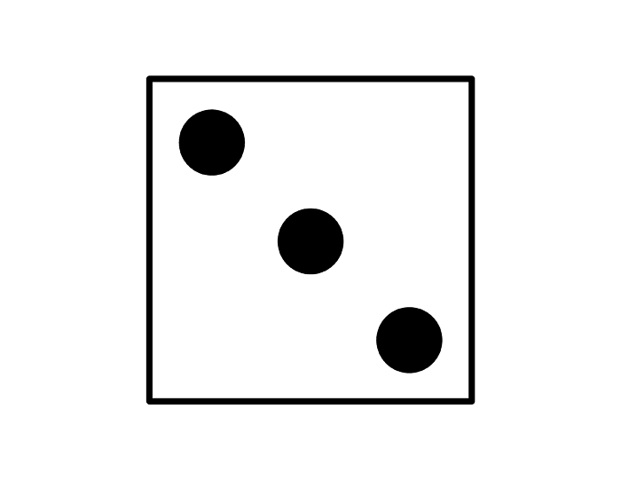

Slide 77
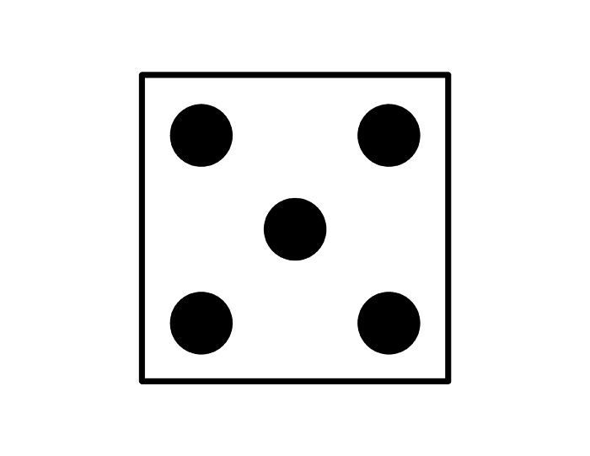

Slide 98
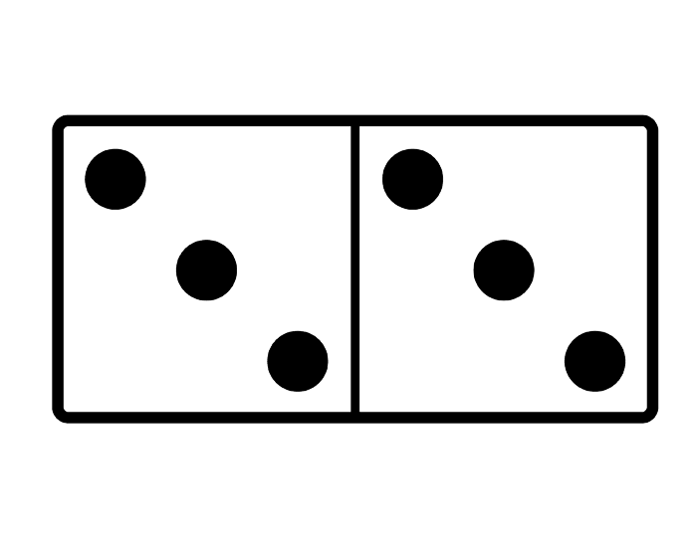

Slide 101
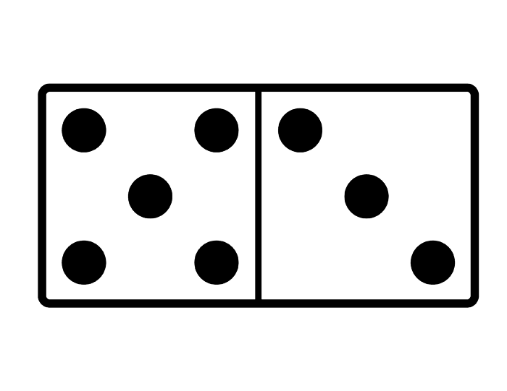

Slide 107
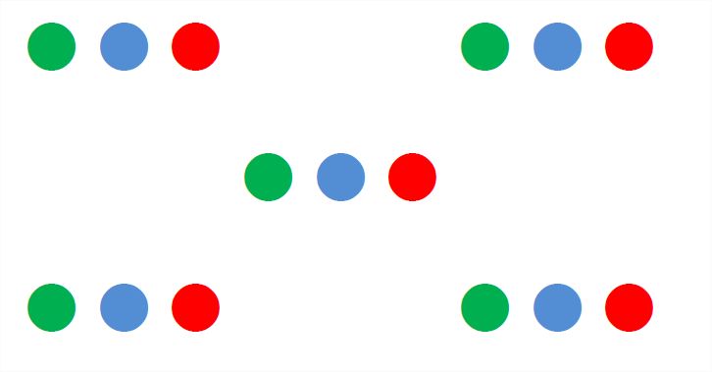

Slide 113
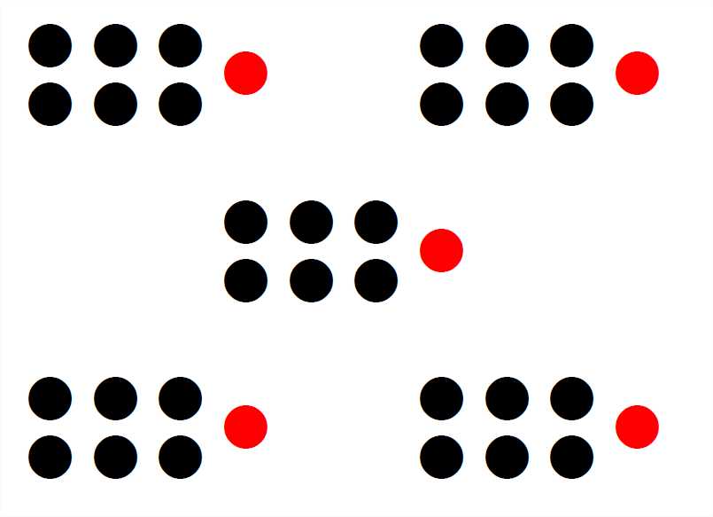

Slide 131
