Slide 1


Activities to Facilitate Middle & Secondary Mathematics
Teachers‘ Transformative Learning of Statistics within PD
KMED
Susan A. Peters
Notes:
Notes included for slides in this PowerPoint are from the facilitator guides that we created to accompany the activities.

Slide 2

Acknowledgement
This work is supported by the National Science Foundation under Grant #1149403. Any opinions, findings, and conclusions or recommendations expressed are those of the author and do not necessarily reflect the views of NSF.

Slide 3

Project
This project informs how teachers reason about and understand variation subsequent to instruction focused on the statistical problem-solving process (Franklin et al., 2007) while incorporating strategies to encourage dilemma, critical reflection, and rational discourse.

Slide 4
GAISE
Guidelines for Assessment and Instruction in Statistics Education (Franklin et al., 2007)
  http://www.amstat.org/education/gaise/GAISEPreK12_Intro.pdf
Statistical Problem-solving Process
  Formulate questions
  Collect data
  Analyze data
  Interpret results

Slide 5

Transformative Learning
Theory of adult learning
Theorized by Mezirow (1991)
Based in constructivism
Premise is that adult learning differs from children’s learning

Slide 6

Transformative Learning
Dilemmas: conflicts triggered from stimuli that signal dissatisfaction with knowledge
Critical Reflection: reflection on premises (why) behind content and processes (what and how)—questioning importance, validity, or utility of knowledge
Rational Discourse: discourse to question assumptions, weigh evidence, and assess justifications

Slide 7

Ready?
7

Slide 8

Teachers’ Work Day
A local newspaper printed results from the American Time Use Survey (ATUS). One result generated community conversation: “on average for all days of the week, teachers worked 18 fewer minutes per day…than all other full-time professionals (Krantz-Kent, 2008).
What information would you like to know about ATUS to discuss the merit of survey results with community members?
8
Notes:
Use the Think-Pair-Share-Square strategy for sharing. Ask teachers to individually respond to the question. After a few minutes, have teachers discuss their responses with a partner. Pairs then join another pair in a square to again share responses and form a collective response to the question.
Ask each group to report out their square group’s responses to the question. Each group shares one piece of information—the most important information—they would like to know about the survey and why before moving on to the next group, who should share a unique piece of information they would like to know. Continue moving from group to group until all aspects are considered.
Design considerations:
How were data from the report selected? (CCSSM: S-IC.6)
From Frequently Asked Questions general information page for the American Time Use Survey at http://www.bls.gov/tus/atusfaqs.htm#1 : “ATUS is sponsored by the Bureau of Labor Statistics and conducted by the U.S. Census Bureau. The Census Bureau collects and processes the data.”
The report took hours working at home into consideration and excluded summer days from consideration. “In the ATUS, interviewers collect data in a time diary format, in which survey participants provide information about activities that they engaged in ‘yesterday.’ Because of the way in which the data are collected, it is possible to identify and quantify the work that teachers do at home, at a workplace, and at other locations and to examine the data by day of the week and time of day”… “All estimates presented are restricted to persons who were employed during the week prior to their interview and who did some work during that period. Thus, a teacher who was on summer or semester break during the week of the survey is not included in this analysis. Unless otherwise specified, data pertain to persons who work full time; that is, they usually work 35 hours or more per week. Estimates of work hours refer to person’s main job only” (Kranz-Kent, 2008, p. 52).
“In the time diary portion of the ATUS interview, respondents sequentially report activities they did between 4 a.m. on the day before the interview ("yesterday") until 4 a.m. on the day of the interview. For each activity, respondents are asked how long the activity lasted.” http://www.bls.gov/news.release/history/atus_09142004.txt
“Households that have completed their final (8th) month of the Current Population Survey [“a monthly survey of households conducted by the Bureau of Census for the Bureau of Labor Statistics” http://www.bls.gov/cps/ ] are eligible for the ATUS. From this eligible group, households are selected that represent a range of demographic characteristics. Then, one person age 15 or over is randomly chosen from the household to answer questions about his or her time use. This person is interviewed for the ATUS 2-5 months after his or her household's final CPS interview.”
“The time use of persons who were doing more than one activity simultaneously is classified according to their primary activity.” (Kranz-Kent, 2008, p. 52)
In 2003, approximately 21,000 individuals were interviewed. In 2004, approximately 14,000 individuals were interviewed. In 2005, approximately 13,000 individuals were interviewed. In 2005, approximately 13,000 individuals were interviewed.
“The data are collected through telephone interviews. Census Bureau interviewers use Computer Assisted Telephone Interviewing, a system that automatically advances interviewers to the next question based on a respondent's answers to previous questions.”
“’Other professionals’ includes health care professionals, business and financial operations professionals, architects and engineers, community and social services profes­sionals, managers, and others.” (Kranz-Kent, 2008, p.55)
“’Average day’ refers to how people spend this time as an average across all 7 days of the week” (Kranz-Kent, 2008, p. 54).

Slide 9

Teachers’ Work Day
Community teachers believe the ATUS report is no longer valid because report data were collected before CCSS-M (2003-2006). They want to collect their own data to take increased demands from CCSSM into consideration.
What issues should they consider to collect data from community teachers? How should the teachers collect data about how much teachers work each day?
9
Notes:
Present teachers with the prompt displayed below printed on a sheet of paper. Ask teachers to individually respond to the question. After a few minutes, have teachers discuss their responses within their squares and ask squares to come to consensus on a response to the questions.
Ask teachers to report out their group responses to the question using the round robin/in-turn response for groups. A group member different from the member who responded to the initial prompt shares the group’s issues and questions considered, how his/her group would suggest collecting data, and how the group’s data collection strategy addresses the issues and questions. After the teacher completes discussing the square’s response, others can ask questions for clarification before the next group shares in the round robin. Sharing should consist of any additional issues or questions considered, the strategies used to collect data, and the rationale behind how the strategies address the issues and questions. Continue until all groups have shared or have nothing further to share. Among the issues to consider are the following related to design. If groups do not raise these issues, then prompt them to consider the issues by asking the suggested questions.
Design considerations:
How should the teachers select other teachers from whom to collect data? (CCSSM: 7.SP.1, S-IC.1)
Idea is to get at sampling methods that might produce a representative sample, such as random sampling, stratified sampling, etc.
This also ties into considering what question the teachers might be hoping to answer. Stress the importance of having a clear question to answer when considering how to collect data or how to interpret collected data.
One aspect of a clear question should also lead to consideration of a clear definition for “work.” For example, in many school systems, busses do not all arrive at schools at the same time or leave schools at the same time. Teachers may be required to stay with students at the beginning of the school day as busses arrive or at the end of the school day until busses for all students arrive. Would such activity be considered work?
How should the teachers collect the data from other teachers? What biases might result from suggested methods? (CCSSM: 6.SP.5)
Idea is to get at how teachers might be surveyed to give accurate answers. For example, teachers directly asking other teachers how many minutes they work might not yield accurate data.
How many teachers should be surveyed? (CCSSM: 7.SP.1, S-IC.1)
Effects of sample size
May bring up the idea of census versus sample
What other information might be necessary to make meaningful conclusions?
May bring up the need to have the data or summaries of the data
Clear definitions of important factors, such as what constitutes work, how to record time, etc.

Slide 10

Teachers’ Work Day
They collect data from community teachers and claim that teachers work longer days than ATUS’s “other full-time professionals.” They also claim that elementary teachers work longer days than middle and secondary teachers.
What question(s) are the teachers investigating? What would you like to know about how they drew their conclusions?
10
Notes:
Present teachers with the prompt displayed below. Use the Think-Pair-Share strategy for sharing. Ask teachers to individually respond to the question. After a few minutes, have teachers discuss their responses with a partner.
Ask teachers to report out their pair responses to the questions using a Whip Around in which we whip around the room with each pair sharing a question under investigation and one thing they would like to know about how the conclusions to the question were drawn. Among the issues to consider are the following related to questions and informal inference. If teachers do not raise these issues, then prompt them to consider the issues by asking the suggested questions.
Question considerations:
Note that there are two questions lurking in the prompt: the question of whether there is a difference in work time between elementary and secondary teachers and the question of whether teachers’ work time differs from that of other professionals.
The difference in work time between elementary and secondary teachers might be stated as a one-sided question about whether elementary teachers work more than secondary teachers.
Note that the questions as stated here are the research questions. Statistical questions as they are referenced in the Common Core require variability in responses. One could consider answers of “yes” or “no” to be varied, but the statistical questions here really relate to the length of the work day for teachers in general and for elementary and secondary teachers in particular.
Inference considerations:
What value or values are considered in drawing conclusions in comparison with the population? To compare elementary and secondary teachers? (CCSSM: 6.SP.2, 6.SP.5, 7.SP.4, S-ID.2)
Asks teachers to consider summary values needed to make meaningful conclusions—hopefully bringing up the idea that both center and spread are needed.
Even if a difference in summary values is revealed, is the difference meaningful? Statistically significant? What conditions would convincingly suggest a difference between teachers’ work day lengths and other professionals’ work day lengths? (CCSSM: S-IC.1)
Note that Minutes for “other full-time professionals” were approximately 504 minutes per day worked.
Implicit is the idea of sampling variability and when a difference might be larger than what chance would suggest
What additional information would be needed to draw conclusions?
May bring up the need to have the data or summaries of the data

Slide 11
Teachers’ Work Day
Using the histograms, what conclusions can you draw about work time for elementary and secondary teachers and why?
11
Notes:
Exploring the Data:
After discussion about the questions and inferential considerations, ask teachers to consider the potentially contentious issue of whether differences exist between the amount of time worked by elementary teachers and the amount of time worked by secondary teachers. Present teachers with the histograms displayed below printed on a sheet of paper. Discuss how to interpret the histogram display, paying attention to the labels and their meanings.
Interpret the meaning of the bars in the display for secondary teachers.
What does the horizontal axis tell us about the displayed data?
What does the vertical axis tell us about the displayed data?
A common error is to interpret the bars as if they represent individual cases rather than frequencies (e.g., Meletiou & Lee, 2002).
Interpret the meaning of the bars in the display for elementary teachers.
Ask teachers to consider: what conclusions would you draw about work time for elementary and secondary teachers? Use Think-Pair-Share-Square strategy for sharing. Ask teachers to individually respond to the question. After a few minutes, have teachers discuss their responses with a partner. Pairs then join another pair in a square to again share responses and form a collective response to the question. (CCSSM: 7.SP.4, S-ID.2)
Ask each group to report out their square group’s responses to the question. Each group shares their response before moving on to the next group, who should share unique aspects from their response. Continue moving from group to group until all aspects are considered. Among the issues to consider are the following related to exploring data. If teachers do not raise these issues, then prompt them to consider the issues by asking the suggested questions.
What do the data reveal about work time between elementary and secondary teachers? (CCSSM: 7.SP.4, S-ID.2)
Idea is to consider mode (modal clumps) and mean
Note the following but do not yet reveal to teachers: the mode of the elementary teachers’ work time is greater than the mode of the secondary teachers’ work time, but the mean of the elementary teachers’ work time is less than the mean of the secondary teachers’ work time.
How did you estimate that/those values?
Students tend to look at the highest-frequency groupings of values to estimate a modal clump (Konold et al., 2002); with respect to the mean, the idea is to start building towards mean as a balance point.
What features do you notice about the data, and how do those features affect your conclusions? (CCSSM: S-ID.3)
Idea is to elicit more than center, specifically variability and distribution
Are the differences between the distributions meaningful? Why or why not? (CCSSM: 7.SP.3)
Building towards inference—might elicit discussion about overlap, which brings the importance of consideration of variability into play
What does the graph reveal about the sample sizes used to examine work times for elementary and secondary teachers?
In this case, the larger sample size for elementary teachers may be deceptive in suggesting that the mean work time for elementary teachers is larger than the mean work time for secondary teachers.
How, if at all, did those sample sizes influence your analyses?

Slide 12
Teachers’ Work Day
What conclusions can you draw about work time for elementary and secondary teachers and why?
How, if at all, do your conclusions about work time differ from using the boxplots in place of the histograms?
12
Notes:
After teachers have had the opportunity to explore the histograms, present teachers with the boxplots displayed below on a sheet of paper. Discuss how to interpret the boxplots.
Interpret the meaning of the boxplot in the display for secondary teachers.
What do the vertical segments tell us about the displayed data?
What do the horizontal segments tell us about the displayed data?
What do the endpoints of the segments tell us about the displayed data?
What do the individual points tell us about the displayed data?
Teachers will not report out their group responses to the questions for boxplots but rather will explore dotplots before coming back to the boxplots. After teachers have had the opportunity to explore the boxplots, groups should inform facilitators when they are ready to consider the dotplots.

Slide 13
Teachers’ Work Day
Compare and contrast what boxplots and histograms reveal or obscure about the relationship between work time for elementary and secondary teachers.
13
Notes:
After teachers have had the opportunity to explore the histograms, present teachers with the boxplots displayed below on a sheet of paper. Discuss how to interpret the boxplots.
Interpret the meaning of the boxplot in the display for secondary teachers.
What do the vertical segments tell us about the displayed data?
What do the horizontal segments tell us about the displayed data?
What do the endpoints of the segments tell us about the displayed data?
What do the individual points tell us about the displayed data?
Teachers will not report out their group responses to the questions for boxplots but rather will explore dotplots before coming back to the boxplots. After teachers have had the opportunity to explore the boxplots, groups should inform facilitators when they are ready to consider the dotplots.

Slide 14
Teachers’ Work Day
What conclusions can you draw about work time for elementary and secondary teachers and why?
How, if at all, do your conclusions about work time differ from using the dotplots?
14
Notes:
Present teachers with the dotplots displayed below on a sheet of paper. Ask teachers to reconsider: what conclusions would you draw about work time for elementary and secondary teachers? (CCSSM: 7.SP.4, S-ID.2) Also ask teachers to consider how their conclusions about work time differ, if at all, between the histogram, boxplot, and dotplot; to consider what the dotplots reveal or obscure about the relationship between work time for elementary and secondary teachers; and to consider how, if at all, the overlap in distributions affects their conclusions.( CCSSM: 7.SP.3)
Upon completing the activity, teachers embark on a One Stay, Rest Stray strategy to discuss the comparisons and conclusions drawn by other groups and to provide feedback. One team member remains with the team’s display to discuss the display with other teams as the individual’s remaining team members rotate to another group. Group members two, three, and four each take a turn staying back and explaining. After groups have had a chance to discuss their results with other teams, team members discuss the differences among the group results they observed and use the information to improve their own conclusions. Among the issues to consider are the following related to exploring data. If teachers do not raise these issues, then prompt them to consider the issues by asking the suggested questions.
What do the data reveal about work time between elementary and secondary teachers? (CCSSM: 7.SP.4, S-ID.2)
With the boxplots, comparisons focused on medians may bring about different conclusions than comparisons focused on the mean or on a modal clump
What value/values did you use to draw that conclusion, and how did you estimate that value/values? (CCSSM: 6.SP.5, 7.SP.4, S-ID.2)
With the boxplots, we should get into what the median as a measure of center reveals about data and the idea of approximately 50% versus exactly 50% of the data is less than or greater than the median
What features do you notice about the data, and how do those features affect your conclusions? (CCSSM: S-ID.3)
Idea is to elicit more than center, specifically variability and distribution
How do your conclusions about work time differ, if at all, between the histogram, the boxplot, and the dotplot?
Teachers are likely to draw different conclusions from histograms than from boxplots. Recognition of differences leads in to the next question.
What do the representations reveal or obscure about the relationship between work time for elementary and secondary teachers?
Neither boxplots nor histograms show individual data values—this leads in to using dotplots.
The histograms seemingly lend themselves to making comparisons using modal clumps. The boxplots lend themselves to making comparisons using the median and quartiles. The histogram also lends itself to estimating the mean from the idea of balance point.
The boxplots obscure information about sample sizes, whereas correct interpretation of histograms allows determination of frequencies.
The dotplots show individual data values.
The dotplots seemingly lend themselves to making comparisons using modal clumps, although perhaps less so given the small number of repeated data values. The dotplots also lend themselves to making comparisons using the median, as the middle data value can be determined relatively easily. The dotplot may lend itself to estimating the mean from the idea of balance point but probably not as easily as for the histograms.
The dotplots make clear the difference in sample sizes.
Outliers are apparent from the boxplots, which leads to the next question.
How, if at all, do the outliers affect your conclusions? (CCSSM: S-ID.3)
Extreme values seem to have a great influence on students’ conclusions when students interpret data.
Are the differences between the distributions meaningful? Why or why not? (CCSSM: 7.SP.3)
The overlap in distributions is likely to suggest little difference in center or in variation.
It might be worthwhile pursuing that center may not be the only differences that researchers might be interested in considering.
How, if at all, does the overlap in distributions affect your conclusions? (CCSSM: 7.SP.3)
The less overlap, the clearer any differences in centers.
Discuss how the variation in data affects the amount of overlap needed to reveal differences in center.

Slide 15
Teachers’ Work Day
Compare and contrast what boxplots, histograms, and dotplots reveal or obscure about the relationship between work time for elementary and secondary teachers.
15
Notes:
Present teachers with the dotplots displayed below on a sheet of paper. Ask teachers to reconsider: what conclusions would you draw about work time for elementary and secondary teachers? (CCSSM: 7.SP.4, S-ID.2) Also ask teachers to consider how their conclusions about work time differ, if at all, between the histogram, boxplot, and dotplot; to consider what the dotplots reveal or obscure about the relationship between work time for elementary and secondary teachers; and to consider how, if at all, the overlap in distributions affects their conclusions.( CCSSM: 7.SP.3)
Upon completing the activity, teachers embark on a One Stay, Rest Stray strategy to discuss the comparisons and conclusions drawn by other groups and to provide feedback. One team member remains with the team’s display to discuss the display with other teams as the individual’s remaining team members rotate to another group. Group members two, three, and four each take a turn staying back and explaining. After groups have had a chance to discuss their results with other teams, team members discuss the differences among the group results they observed and use the information to improve their own conclusions. Among the issues to consider are the following related to exploring data. If teachers do not raise these issues, then prompt them to consider the issues by asking the suggested questions.
What do the data reveal about work time between elementary and secondary teachers? (CCSSM: 7.SP.4, S-ID.2)
With the boxplots, comparisons focused on medians may bring about different conclusions than comparisons focused on the mean or on a modal clump
What value/values did you use to draw that conclusion, and how did you estimate that value/values? (CCSSM: 6.SP.5, 7.SP.4, S-ID.2)
With the boxplots, we should get into what the median as a measure of center reveals about data and the idea of approximately 50% versus exactly 50% of the data is less than or greater than the median
What features do you notice about the data, and how do those features affect your conclusions? (CCSSM: S-ID.3)
Idea is to elicit more than center, specifically variability and distribution
How do your conclusions about work time differ, if at all, between the histogram, the boxplot, and the dotplot?
Teachers are likely to draw different conclusions from histograms than from boxplots. Recognition of differences leads in to the next question.
What do the representations reveal or obscure about the relationship between work time for elementary and secondary teachers?
Neither boxplots nor histograms show individual data values—this leads in to using dotplots.
The histograms seemingly lend themselves to making comparisons using modal clumps. The boxplots lend themselves to making comparisons using the median and quartiles. The histogram also lends itself to estimating the mean from the idea of balance point.
The boxplots obscure information about sample sizes, whereas correct interpretation of histograms allows determination of frequencies.
The dotplots show individual data values.
The dotplots seemingly lend themselves to making comparisons using modal clumps, although perhaps less so given the small number of repeated data values. The dotplots also lend themselves to making comparisons using the median, as the middle data value can be determined relatively easily. The dotplot may lend itself to estimating the mean from the idea of balance point but probably not as easily as for the histograms.
The dotplots make clear the difference in sample sizes.
Outliers are apparent from the boxplots, which leads to the next question.
How, if at all, do the outliers affect your conclusions? (CCSSM: S-ID.3)
Extreme values seem to have a great influence on students’ conclusions when students interpret data.
Are the differences between the distributions meaningful? Why or why not? (CCSSM: 7.SP.3)
The overlap in distributions is likely to suggest little difference in center or in variation.
It might be worthwhile pursuing that center may not be the only differences that researchers might be interested in considering.
How, if at all, does the overlap in distributions affect your conclusions? (CCSSM: 7.SP.3)
The less overlap, the clearer any differences in centers.
Discuss how the variation in data affects the amount of overlap needed to reveal differences in center.

Slide 16

Teachers’ Work Day
Draw a rough sketch of distributions that would reveal meaningful differences in work times between elementary and secondary teachers.
16
Notes:
Ask teachers to draw a rough sketch of distributions that would reveal meaningful differences in work times between elementary and secondary teachers on chart paper and post. (CCSSM: 6.SP.4, S-ID.1) Have groups examine each other’s sketches, and discuss similarities and differences among hypothesized distributions.
Note that students have trouble drawing a smooth curve for data because they tend to view data as individual values rather than as an aggregate.
Consider taking pictures of teachers’ sketches and possibly posting sketches on the group wikispace or projecting sketches for further discussion.

Slide 17
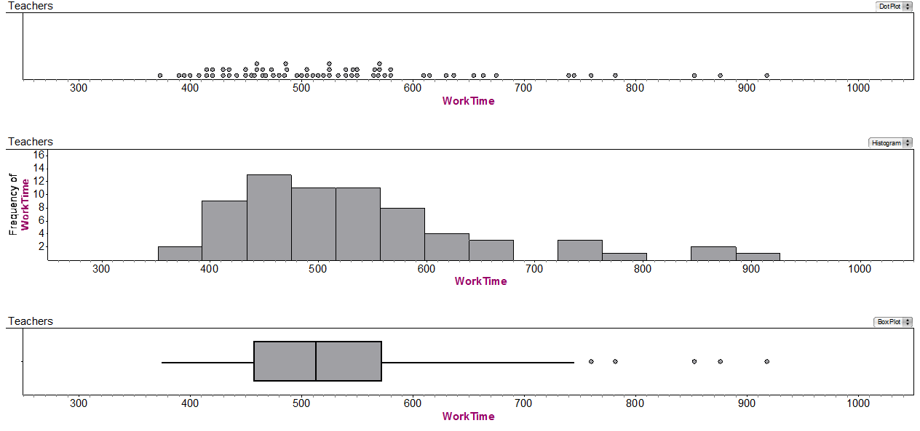
Teachers’ Work Day
Describe the distribution of work times for teachers.
17
Notes:
After discussing differences in work time between elementary and secondary teachers, ask teachers to return to the initial issue of whether teachers work less time than “all other full-time professionals.” Present teachers with the graphs displayed below on a sheet of paper. Ask teachers to consider: what conclusions would you draw about work time for teachers in comparison with the approximately 504 minutes per day worked by all other full-time professionals? (CCSSM: 7.SP.4, S-ID.2)
Ask teachers to report out their group responses to the question using a variation of the Cooperative Dialogue. Within groups, each teacher should assume a unique number from 1 to 4, inclusive. Teachers then join with teachers from the other groups with the same number and each share their group’s conclusions with the other groups. Among the issues to consider are the following. If teachers do not raise these issues, then prompt them to consider the issues by asking the suggested questions.
Using any of the three displays, estimate the mean work time for teachers, and describe how you determined your estimate. (CCSSM: 6.SP.5)
The question is designed to lead into consideration of mean as a balance point.
At some point, it will be important to consider finding the mean as a balance point from a histogram and the mean as fair share from a case value plot.
Between the mean and the median, which better represents work times and why? (CCSSM: 6.SP.5, S-ID.3)
Discuss how shape and outliers affect the mean in comparison with the median.
Bring in the idea of resistance.
What can be said about the spread of the data and why? (CCSSM: 6.SP.5, S-ID.3)
Most likely, the focus will be on the range. Bringing in the idea of resistance, consider the merit in using the range.
Begin to consider interpretations of interquartile range and standard deviation. Of importance for standard deviation is the focus on deviation from the mean.
If the average work time for “all other full-time professionals” is approximately 504 minutes, do the data provide evidence of a difference in work time for teachers? A meaningful difference? (CCSSM: 7.SP.4, S-ID.2)

Slide 18
Teachers’ Work Day
What conclusions would you draw about work time for teachers in comparison with the approximately 504 minutes per day worked by all other full-time professionals?
18
Notes:
After discussing differences in work time between elementary and secondary teachers, ask teachers to return to the initial issue of whether teachers work less time than “all other full-time professionals.” Present teachers with the graphs displayed below on a sheet of paper. Ask teachers to consider: what conclusions would you draw about work time for teachers in comparison with the approximately 504 minutes per day worked by all other full-time professionals? (CCSSM: 7.SP.4, S-ID.2)
Ask teachers to report out their group responses to the question using a variation of the Cooperative Dialogue. Within groups, each teacher should assume a unique number from 1 to 4, inclusive. Teachers then join with teachers from the other groups with the same number and each share their group’s conclusions with the other groups. Among the issues to consider are the following. If teachers do not raise these issues, then prompt them to consider the issues by asking the suggested questions.
Using any of the three displays, estimate the mean work time for teachers, and describe how you determined your estimate. (CCSSM: 6.SP.5)
The question is designed to lead into consideration of mean as a balance point.
At some point, it will be important to consider finding the mean as a balance point from a histogram and the mean as fair share from a case value plot.
Between the mean and the median, which better represents work times and why? (CCSSM: 6.SP.5, S-ID.3)
Discuss how shape and outliers affect the mean in comparison with the median.
Bring in the idea of resistance.
What can be said about the spread of the data and why? (CCSSM: 6.SP.5, S-ID.3)
Most likely, the focus will be on the range. Bringing in the idea of resistance, consider the merit in using the range.
Begin to consider interpretations of interquartile range and standard deviation. Of importance for standard deviation is the focus on deviation from the mean.
If the average work time for “all other full-time professionals” is approximately 504 minutes, do the data provide evidence of a difference in work time for teachers? A meaningful difference? (CCSSM: 7.SP.4, S-ID.2)

Slide 19
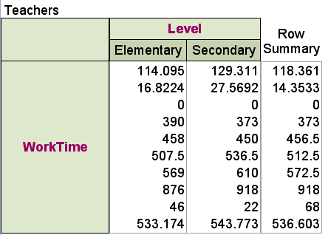
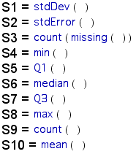
Teachers’ Work Day
Consider whether the information brings into your conclusions about differences in work time between elementary and secondary teachers and whether teachers work less time than “all other full-time professionals.”
19
Notes:
While teachers are in their groups of 1’s, 2’s, 3’s, and 4’s, present teachers with the summary values displayed below printed on a sheet of paper. Ask teachers to first individually consider whether the information brings into question any aspect of their conclusions about differences in work time between elementary and secondary teachers and whether teachers work less time than “all other full-time professionals.” After thinking about their individual responses to the question, ask teachers to discuss their thoughts within the group. Teachers then should move back to their original group of four to discuss how they would respond to the prompt. Then ask teachers to consider which measure best represents these data, the mean or the median, and to interpret the meaning of standard deviation for these data. (CCSSM: 6.SP.5, S-ID.3)
If the average work time for “all other full-time professionals” is approximately 504 minutes, do the data provide evidence of a difference in work time for teachers? A meaningful difference? What would provide evidence of a meaningful difference? (CCSSM: 7.SP.4, S-ID.2)
Building towards inference and the idea of sampling variability versus systematic variability due to differences
Between the mean and the median, which better represents elementary and secondary work times and why? (CCSSM: 6.SP.5, S-ID.3)
Discuss how shape and outliers affect the mean in comparison with the median.
Bring in the idea of resistance.
What do the standard deviation values tell you about the data? (CCSSM: 6.SP.5, S-ID.3)
Begin to consider interpretations of standard deviation. Of importance for standard deviation is the focus on deviation from the mean.

Slide 20
Teachers’ Work Day
Between the mean and the median, which better represents elementary and secondary work times and why?
What do the standard deviation values tell you about the data?
20
Notes:
While teachers are in their groups of 1’s, 2’s, 3’s, and 4’s, present teachers with the summary values displayed below printed on a sheet of paper. Ask teachers to first individually consider whether the information brings into question any aspect of their conclusions about differences in work time between elementary and secondary teachers and whether teachers work less time than “all other full-time professionals.” After thinking about their individual responses to the question, ask teachers to discuss their thoughts within the group. Teachers then should move back to their original group of four to discuss how they would respond to the prompt. Then ask teachers to consider which measure best represents these data, the mean or the median, and to interpret the meaning of standard deviation for these data. (CCSSM: 6.SP.5, S-ID.3)
If the average work time for “all other full-time professionals” is approximately 504 minutes, do the data provide evidence of a difference in work time for teachers? A meaningful difference? What would provide evidence of a meaningful difference? (CCSSM: 7.SP.4, S-ID.2)
Building towards inference and the idea of sampling variability versus systematic variability due to differences
Between the mean and the median, which better represents elementary and secondary work times and why? (CCSSM: 6.SP.5, S-ID.3)
Discuss how shape and outliers affect the mean in comparison with the median.
Bring in the idea of resistance.
What do the standard deviation values tell you about the data? (CCSSM: 6.SP.5, S-ID.3)
Begin to consider interpretations of standard deviation. Of importance for standard deviation is the focus on deviation from the mean.

Slide 21
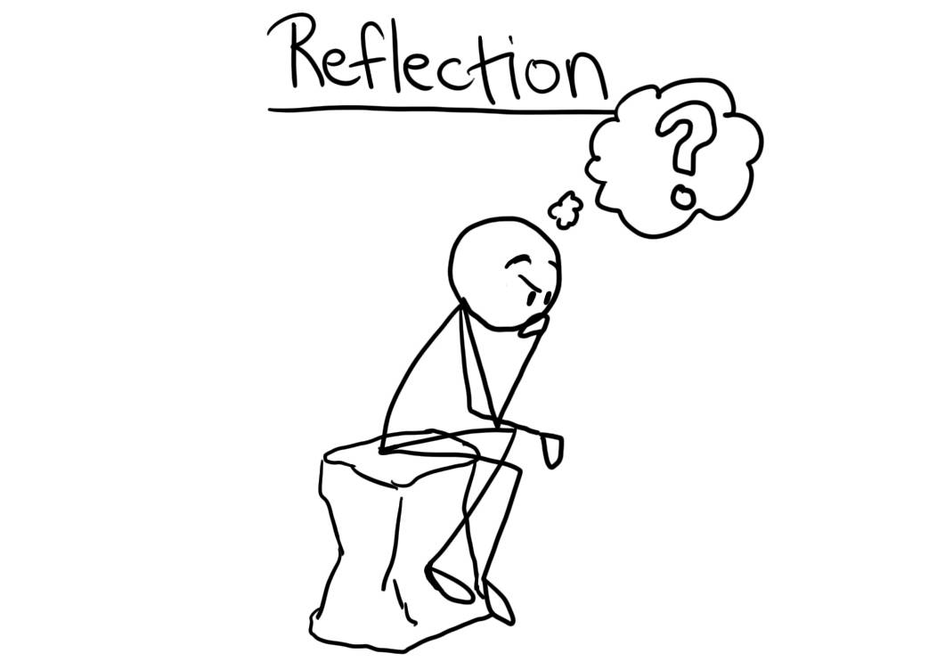
Reflection on Activity
The activity is likely to be longer than those you will use with your students. What can you take from this activity for your classroom?
The teacher workday context is not likely to be as engaging for students as for teachers. What contexts might be of interest to students?
What important aspects of data analysis surfaced while working through the activity?
21
Notes:
Take-home Messages:
The activity we just explored is likely to be longer than those you will pursue with your students. What can you take from this activity to use in your classroom?
The context of teachers’ work-days is not likely to be as engaging for students as it is for teachers. What contexts could be of interest to students?
Share resource sites for downloading data, such as the following.
Data and Story Library: http://lib.stat.cmu.edu/DASL/
StatLib: http://lib.stat.cmu.edu/modules.php?op=modload&name=Downloads&file=index&req=viewdownload&cid=2
Journal of Statistics Education Data Archive: http://www.amstat.org/publications/jse/jse_data_archive.htm
Sports Data Resources: http://www.amstat.org/sections/SIS/Sports%20Data%20Resources/
Exploring Data: http://exploringdata.net/
FedStats government data: http://www.fedstats.gov/
StatSci.org links to data resources: http://www.statsci.org/datasets.html
Share means for collecting data from students, such as the following.
Census at School: http://www.amstat.org/censusatschool/
Google Forms: http://www.google.com/drive/apps.html
Fathom Surveys: http://www.keycurriculum.com/resources/fathom-resources/fathom-surveys
SurveyMonkey: http://www.surveymonkey.com/
What important aspects of data analysis surfaced while working through different aspects of the task?
Need to have a clear question or questions in mind before collecting or analyzing data
Design considerations given context before exploring data
Comparing data sets to motivate need for measures of center and spread
Consider informal inferences early and often
Use multiple representations
Constantly question the data
Beyond the statistical content goals associated with this exploration, what pedagogical goals might the facilitators had in mind for this exploration?
Discuss the formative assessment function of the activity. The activity can provide valuable information about teachers’ backgrounds with respect to sampling and observational study design/survey design, interpreting graphical representations, calculating and interpreting numerical measures, and comparing distributions to draw informal inferences from data.
Consider sharing the preplanning needed to design an exploration such as the Teachers’ Work Day Length Task.

Slide 22
Teachers’ Work Day
What important statistical ideas do teachers explore during this activity?
What adaptations/extensions might be needed for use with preservice teachers?

Slide 23

Teachers’ Work Day
What does the DRAFT language mean?
23

Slide 24
Prior Work for Two Activities
Typical Age
Teachers described age(s) of children who are members of their households.
Teachers compared displays and interpretations of “typical” and questions to answer from collected data.
Teachers recorded definitions of mean, median, and mode.
Blood Pressure: Revisited
Teachers explored their systolic blood pressure data to consider center as signal within noise of data.
Teachers completed investigations on center, variation, distribution, and design.
Focus only on one of the activities.

Slide 25

Focus on:
What are key characteristics of the activities?
How might the activities enable development of conceptual understanding?
What adaptations and extensions might be needed for use with preservice teachers or with in-service teachers in diverse professional development settings?

Slide 26

Questions & Discussion

Slide 27
s.peters@louisville.edu

